Slide 1
Exploring and Troubleshooting Your Builds
Warren Frame

Slide 2
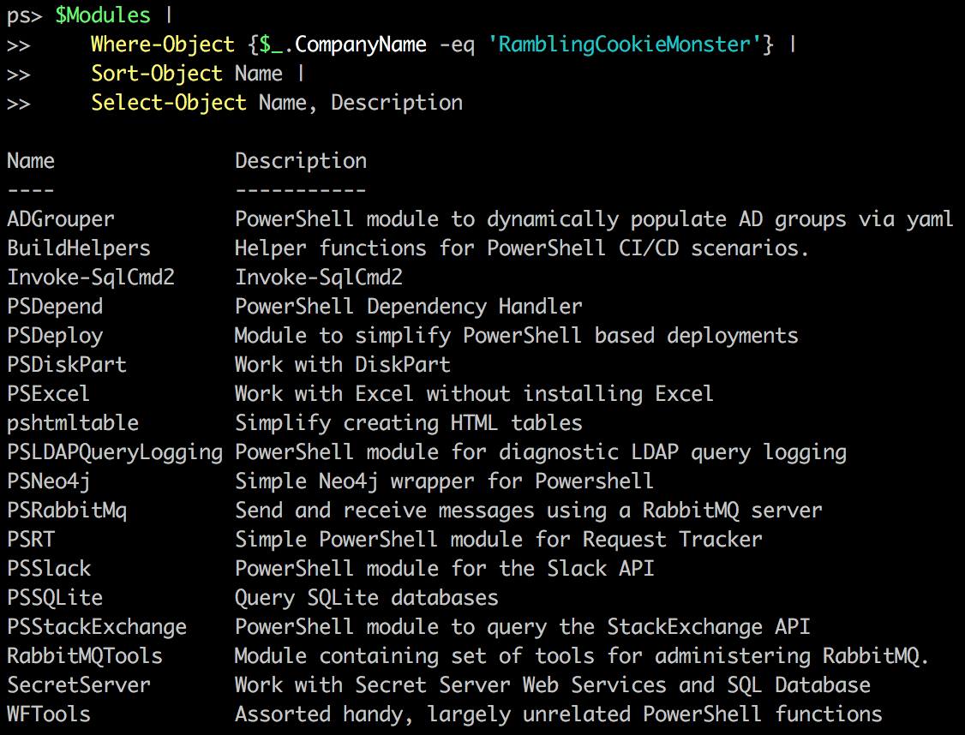




About Me
Where to find me
Twitter.com/PSCookieMonster
LinkedIn.com/in/wframe
RamblingCookieMonster.github.io
Github.com/RamblingCookieMonster
PowerShell Slack Community
Notes:
BuildHelpers, PSDeploy, PSDepend
PSSlack

Slide 3


Slide 4
Where Does This Apply?
To pretty much anything that doesn’t run interactively

Slide 5

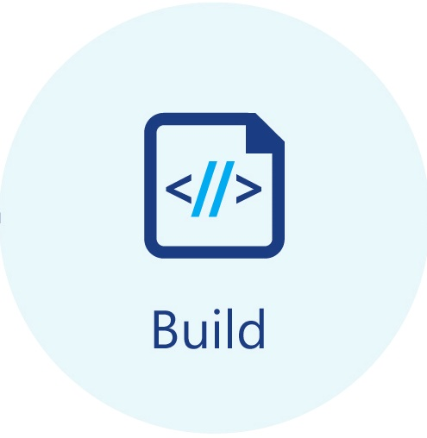

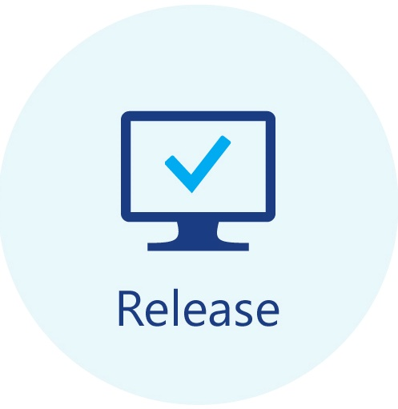










Build Systems – CI, CD, Release Pipelines, etc.

Slide 6
Scheduled Tasks, Runbooks, etc.

Slide 7
Scripts-As-A-Service
Jenkins
WebCommander
PoshBot
FAAS - Azure Functions, etc.
Notes:
Jenkins:
https://hodgkins.io/automating-with-jenkins-and-powershell-on-windows-part-1
https://hodgkins.io/automating-with-jenkins-and-powershell-on-windows-part-2
PoshBot:
https://github.com/poshbotio/PoshBot
http://ramblingcookiemonster.github.io/PoshBot/
WebCommander:
https://github.com/vmware/webcommander
Azure Functions:
https://blogs.msdn.microsoft.com/powershell/2017/02/24/using-powershell-modules-in-azure-functions/
https://blogs.msdn.microsoft.com/mvpawardprogram/2017/08/15/serverless-azure-functions/
https://www.youtube.com/watch?v=_NZuuQ5rUJM

Slide 8
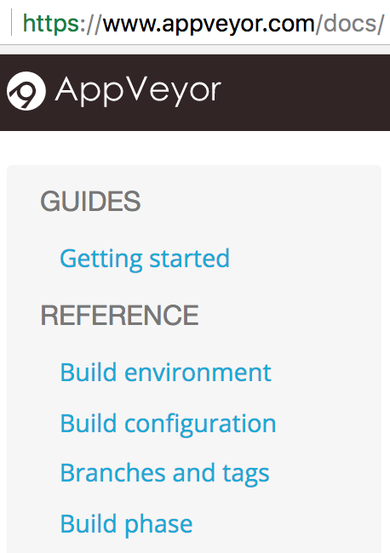
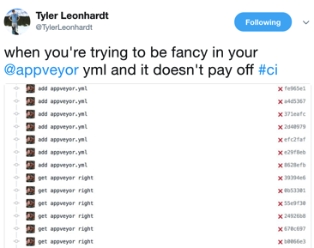

Exploring and Troubleshooting
Read
Experiment
Assumed: Ask questions
Notes:
https://www.appveyor.com/docs/
https://docs.gitlab.com/ce/ci/README.html

Slide 9
Experimenting
Problem: These aren’t interactive!
Potential solution:
Run your debug query, figure out what to do with the output:
Write it out
Bundle up output and put it somewhere accessible
Send it to another system
Interact(ish)

Slide 10
Examples and Demos
Notes:
GitLab CE CI
AppVeyor

Slide 11
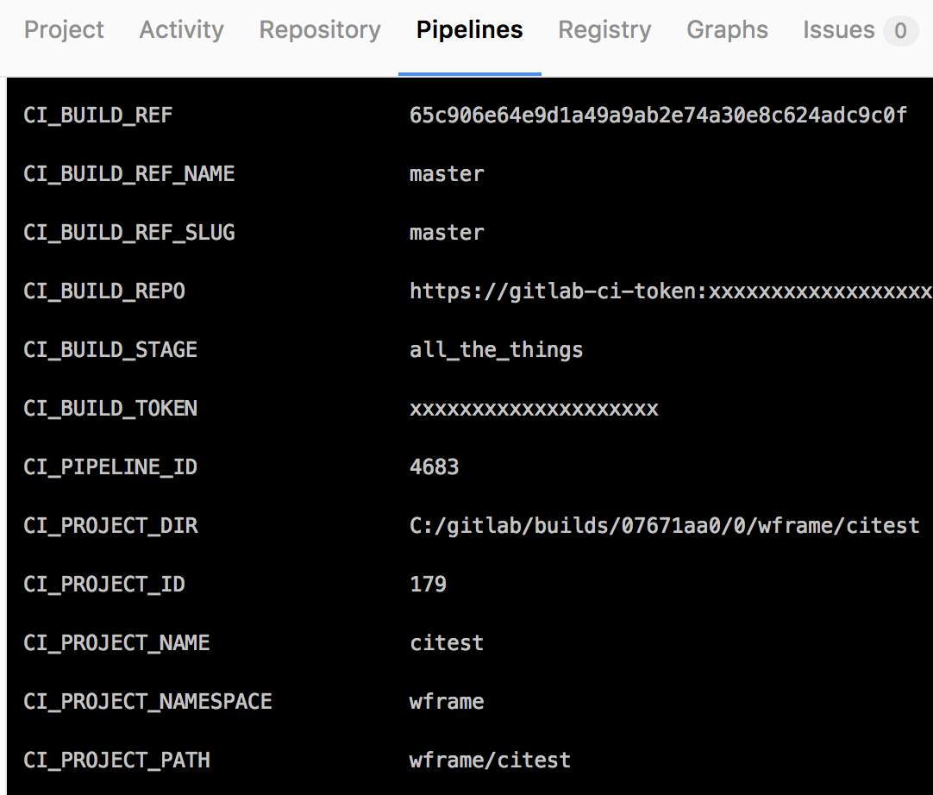
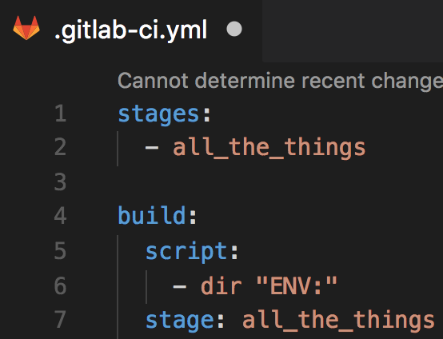
What Variables are Available? Experimenting
Notes:
I tend to read first, experiment second, but all depends!
A look at writing things to output. GitLab isn’t quite as nice with colors or formatting in their build logs
This works, but depending on what you want to collect, it doesn’t scale:
https://ci.appveyor.com/project/RamblingCookieMonster/zappveyor-explore

Slide 12
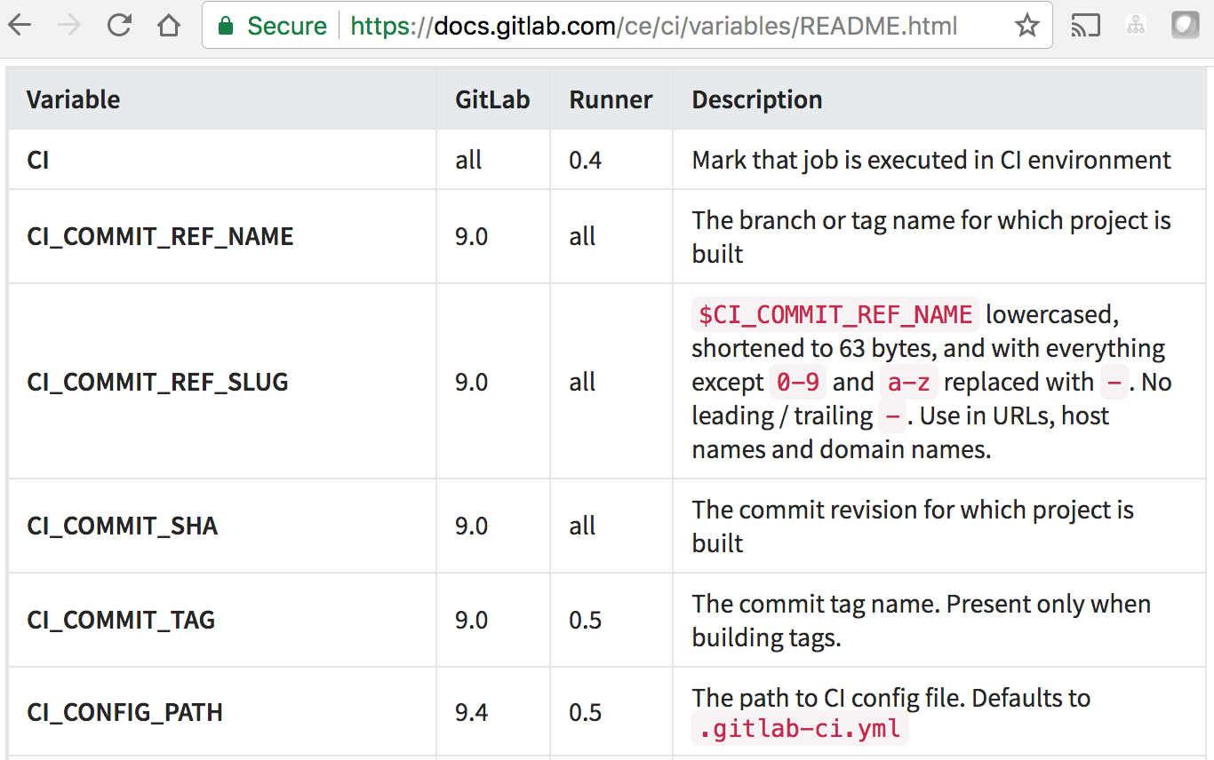
What Variables are Available? Reading
Wait… What do those values actually mean? Read the docs!
Notes:
https://docs.gitlab.com/ce/ci/variables/README.html
https://www.appveyor.com/docs/environment-variables
https://github.com/RamblingCookieMonster/BuildHelpers
Gathers from:
AppVeyor
GitLab CI
Jenkins
Teamcity
VSTS
Bamboo
GoCD
Travis CI

Slide 13
Questions?

Slide 14
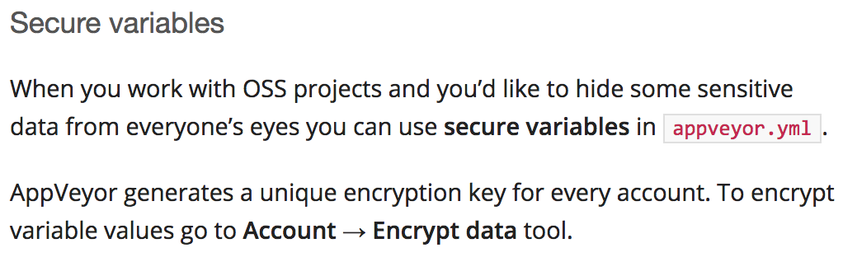
How Do I Store a Secret? Reading
In source control
Read the docs!
Other options
Serialized on build node. Problem: Tightly coupled to node. potential risk.
Actual secret management*. Problem: You might not have this.
* Not KeyPass or anything like it. Audit, authentication, etc. are important
Notes:
https://www.appveyor.com/docs/build-configuration/#secure-variables
https://docs.gitlab.com/ce/ci/variables/README.html#secret-variables
Vault, Secret Server, etc.

Slide 15
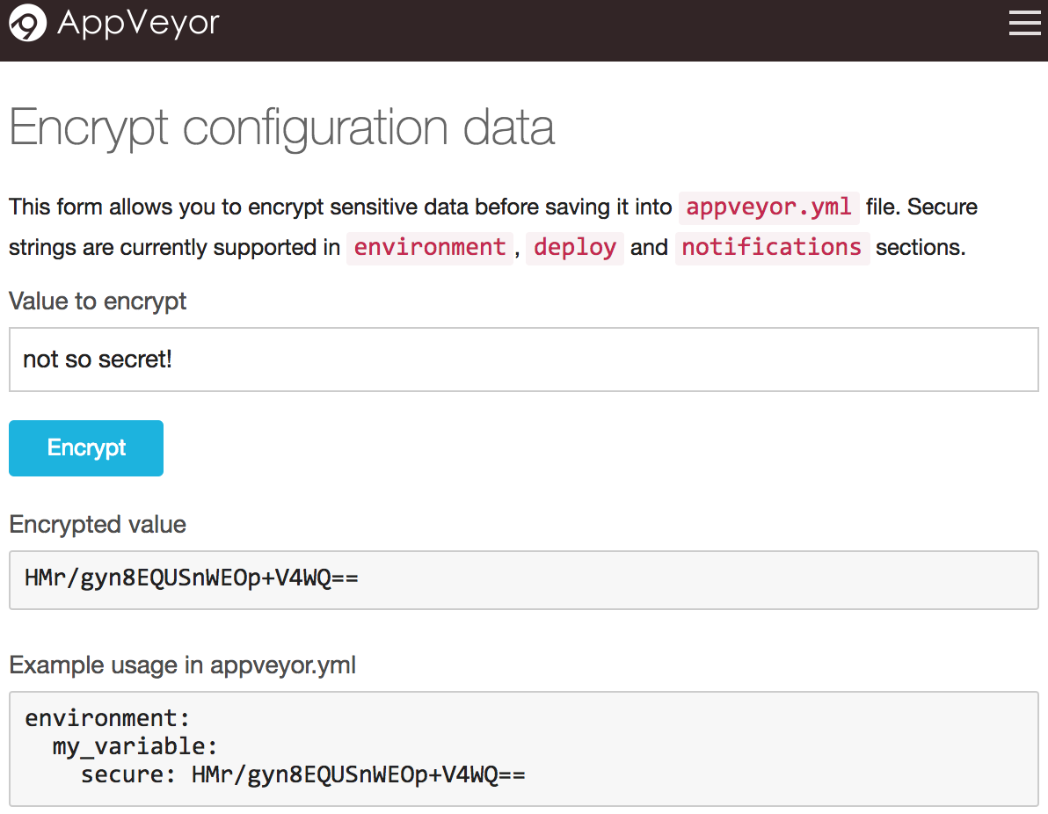
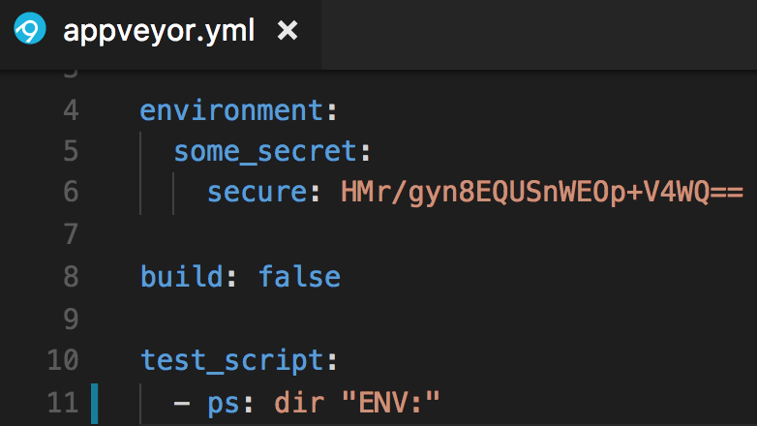
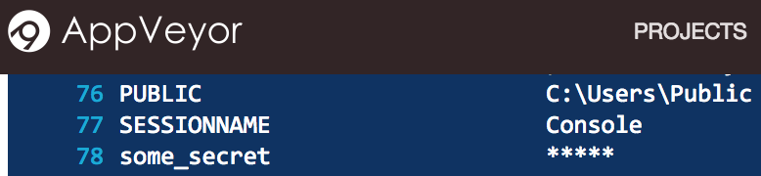
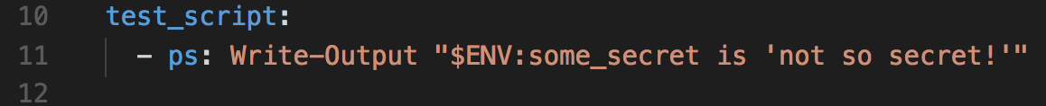
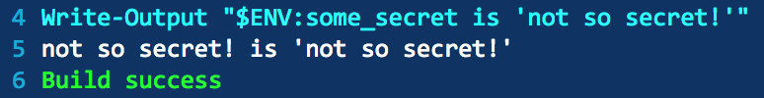
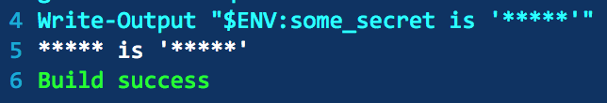
How Do I Store a Secret? Experimenting
Notes:
TIL! You’ll see the secret while the build is in progress. Once complete, any secret variable values found in the log are sanitized. Pretty cool
https://help.appveyor.com/discussions/problems/9079-appveyor-secure-var-docker-login-doesnt-work

Slide 16
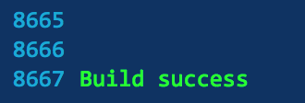
Who wants to scroll through build logs?
Serialize, place somewhere accessible, rehydrate in PowerShell!
Send bits to chat or other systems
important

Slide 17
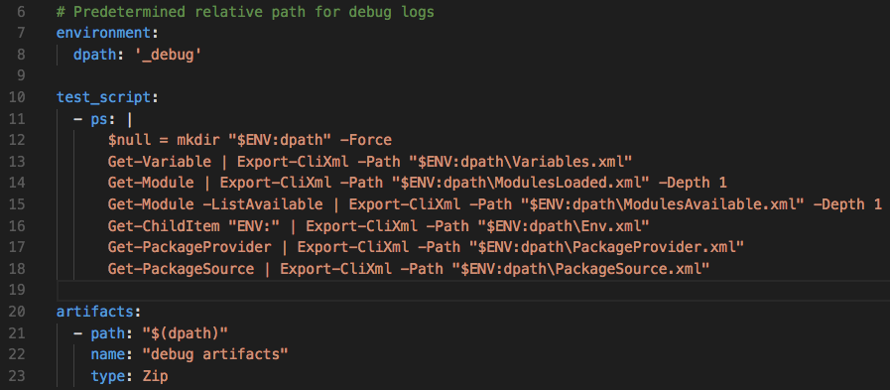
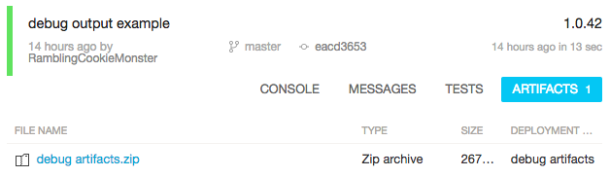
Debug Artifacts
Notes:
https://www.appveyor.com/docs/packaging-artifacts/
https://docs.gitlab.com/ce/user/project/pipelines/job_artifacts.html

Slide 18
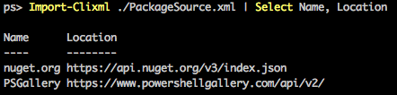
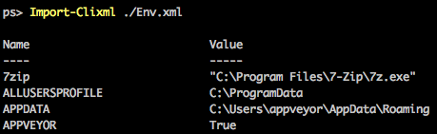
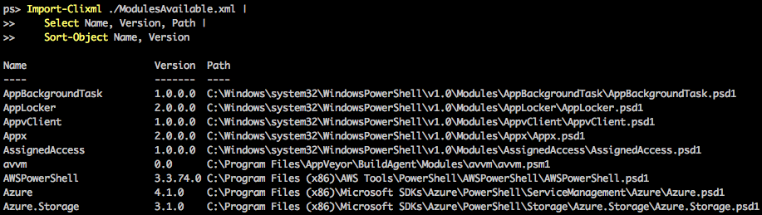
Debug artifacts

Slide 19
Questions?

Slide 20
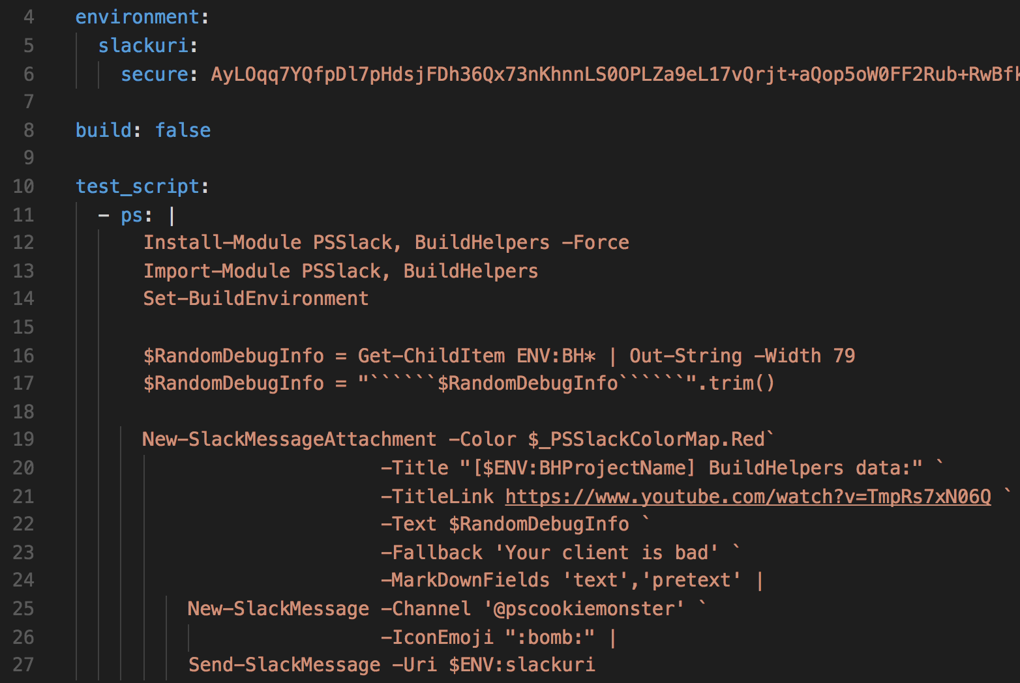
Notifications
Notes:
https://www.appveyor.com/docs/notifications/#slack
https://www.appveyor.com/docs/notifications/#webhook-payload-default (data you can include in template)
https://docs.gitlab.com/ce/user/project/integrations/slack.html

Slide 21
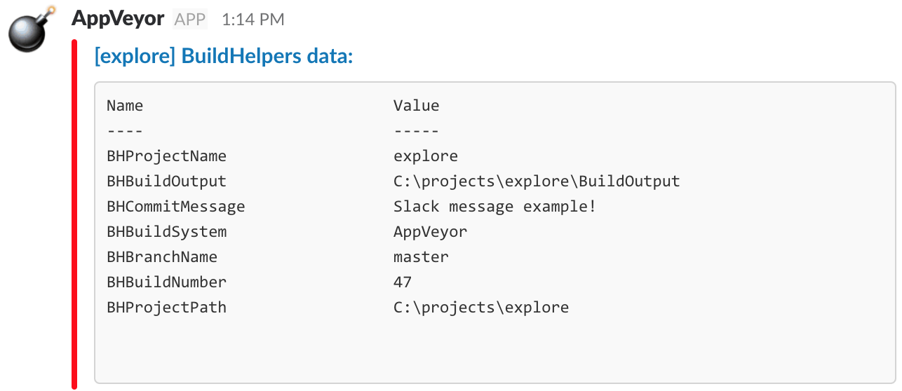
Notifications

Slide 22
Interact(ish)
Some CI services support this
You can build it into your internal CI system
Notes:
https://www.appveyor.com/docs/how-to/rdp-to-build-worker/
https://help.appveyor.com/discussions/problems/5961-cant-rdp-to-build-agent
https://help.appveyor.com/discussions/problems/9599-rdp-invalid-login-credentials

Slide 23
Common Scenarios

Slide 24
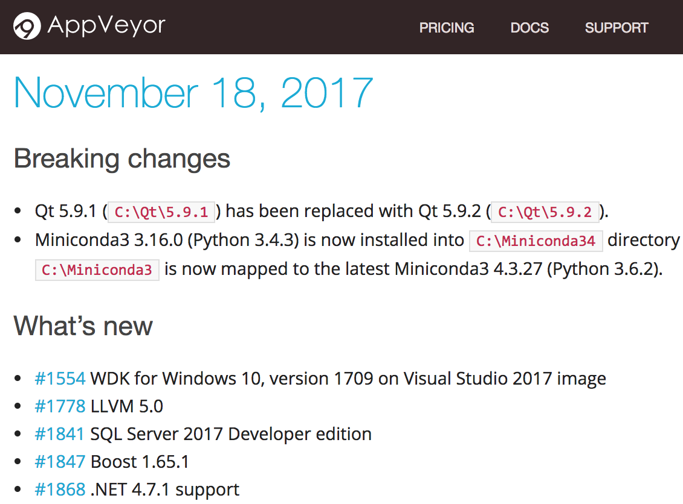
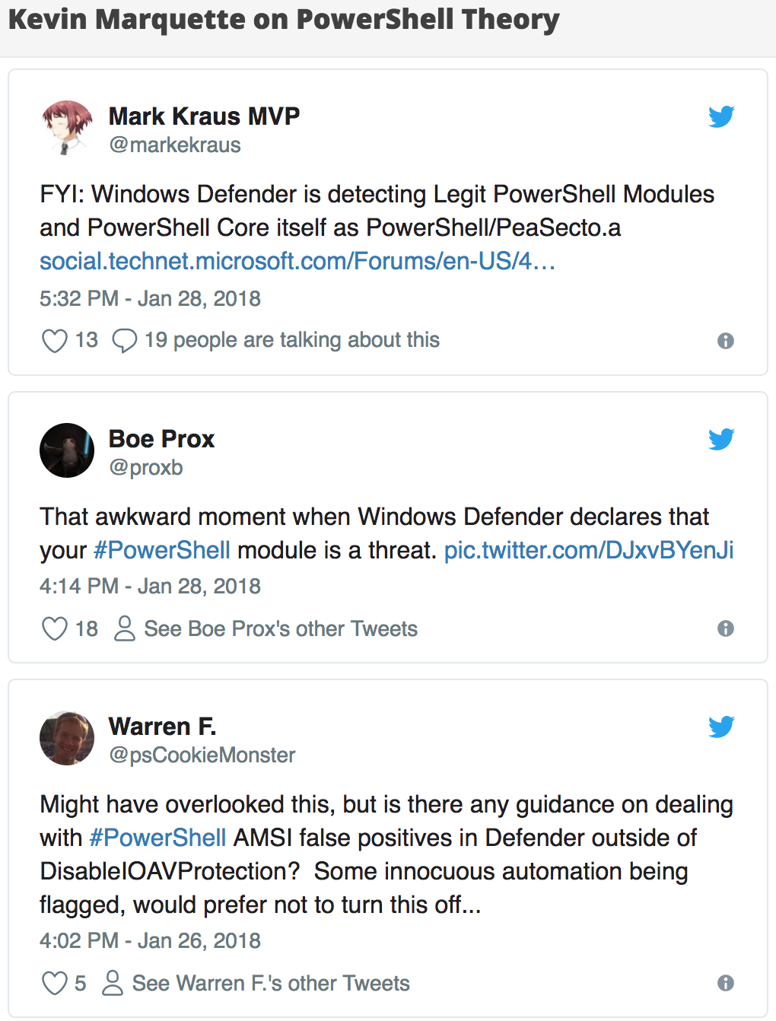
Changes to build nodes
Notes:
https://www.appveyor.com/updates/
https://kevinmarquette.github.io/2018-01-28-Powershell-windows-defender-peasceto-powershell/

Slide 25
Fun with Dependency Management!

Slide 26
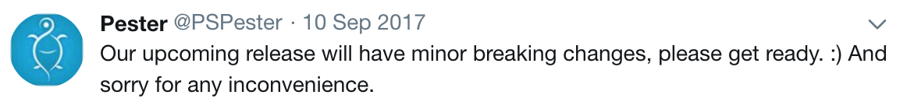
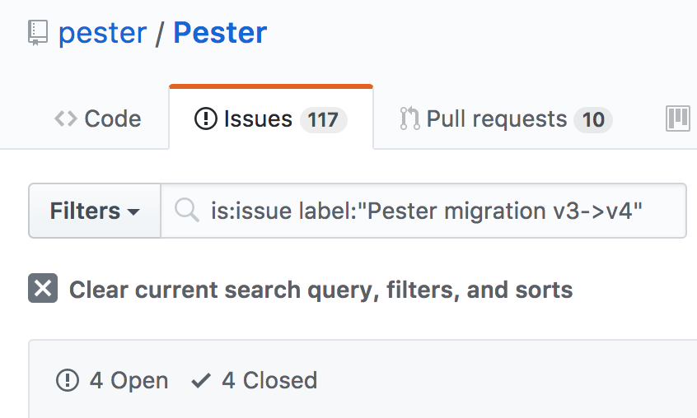
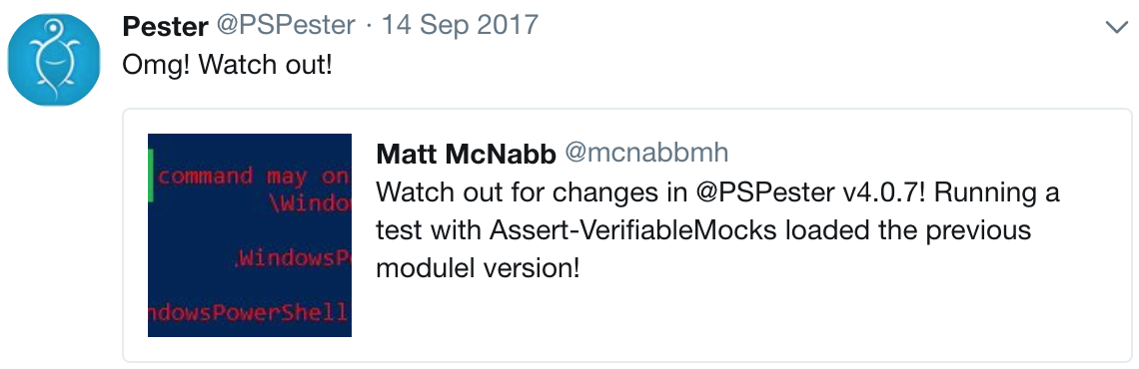
Fun with Dependency Management!

Slide 27
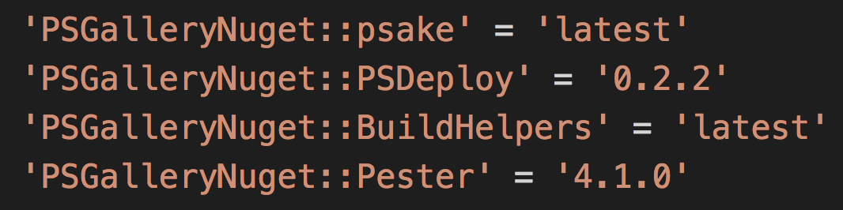
Fun with Dependency Management!
Notes:
https://github.com/RamblingCookieMonster/PSDepend
https://github.com/PowerShell/PowerShell/issues/5171

Slide 28
New Use Cases or Requirements
We just set up Artifactory, let’s deploy to it!
Let’s set it up to notify our beta customers!
Can we integrate Test-Kitchen?
Can we send this to Splunk?
Can we do <new thing> based on branch/commit message/etc.?
Let’s hook this up to our monitoring system!
How can we add security / compliance testing?
Notes:
https://jfrog.com/artifactory/
https://kitchen.ci/

Slide 29
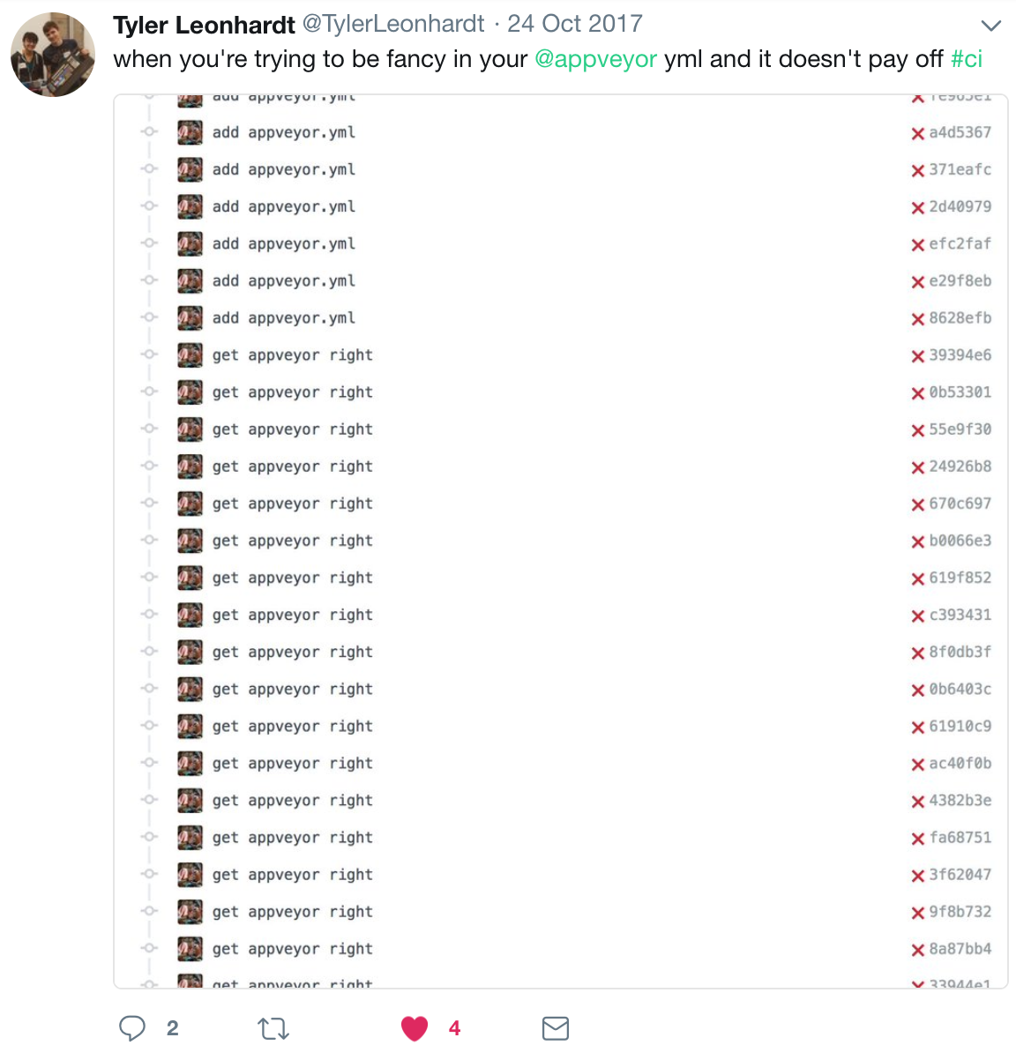
Designing or updating your build/build system

Slide 30


Questions?

